Slide 1
ONLINE RADDIWALA
SELL PAPERS, SAVE TRESS…

Slide 2
INTRODUCTION
Disposal of raddi material nowadays is to complicated due to growing population and weak management of scrap dealers. People have to wait for weeks for the scrappe's to come and borrow the scrap.
Most of people burn papers just to get rid of scrap. So, why to burn them if they can be recycled and reused? Why can't scrap be disposed for recycling?
Answer to this is our website online raddiwala. We provide door to door pickup of scrap from the location given by costumers. We borrow the material at very fair prices. Later scarp is given for recycling
Hence proper use reuse of scrap can be done. Which helps the environment to be clean and can also prevent pollution

Slide 3
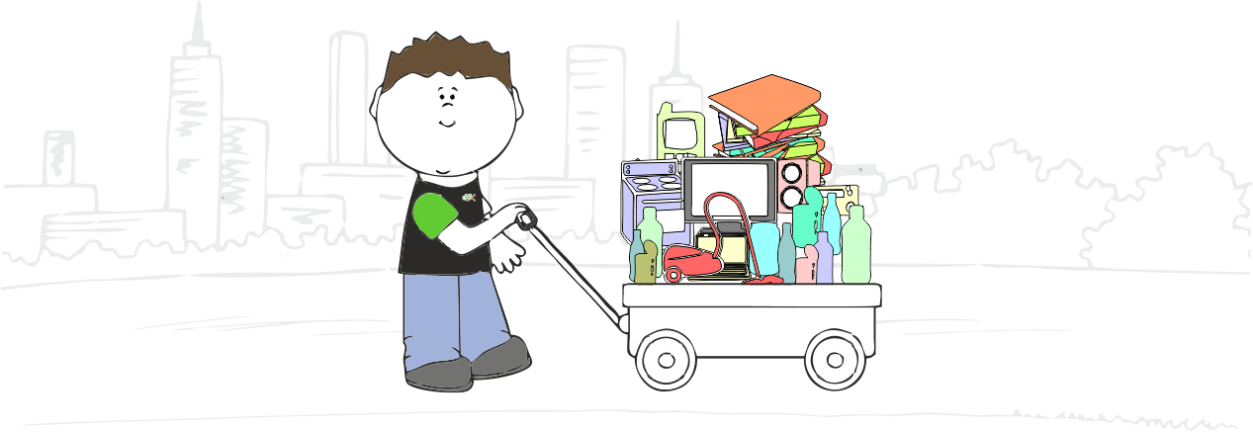

Slide 4
WEBPAGE…… BUT WHY?
Different E-Commerce websites, apps, pages are very trendy. e.g. OLX, Book My Show, etc.
Need of system in order to have standardized rates, better management and coordination with customers.

Slide 5


Slide 6
WHAT CAN WE DO AS TECHIES??
Buying products online is easy. Getting rid of them when it becomes useless/redundant/old, is not. You have two options – either sell it in a second-hand market online or call the kabadiwala or raddiwala to get rid of it.
First, you have to find them, coordinate timings, and then haggle but we have developed a platform to help users which helps users to book a request in less than 2 seconds and schedule it as per their convenience.

Slide 7
PROBLEMS FACING TO SELL RADDI OFFLINE
Scrap collection is not regular since the scrappie's aren't able to find out who exactly wants to sell scrap. They get out only in particular areas according to their time. Selling scrap online can directly give them the location from where the scrap is to be picked up
It is unable for the scrap dealer to pick up big quantity of scrap at a time due to transportation methods they use. Online selling gives the idea of quantity to be picked .which helps both the costumer and the dealers

Slide 8
CONTINUED…
Offline selling may not have any safety. Selling online can later be useful to find out the dealer back if costumer mistakely dumped his/her important documents or material in scrap.

Slide 9
HERE SYSTEMS NEED BETTER SOLUTIONS…
Most of the times, different pricing is observed at different shops in same city.
Also due to lack of standardized instruments for weighing, weights are less accurately measured. This leads to dissatisfaction of both customers and scrap collectors

Slide 10

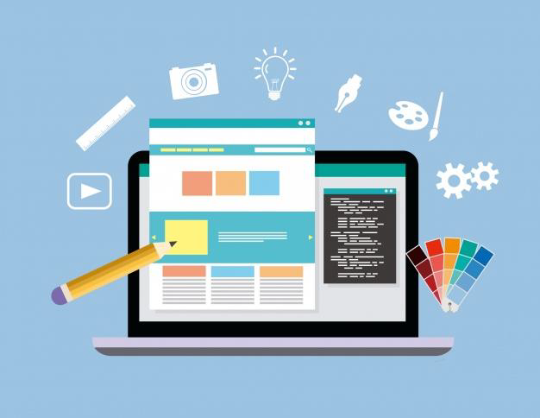

Slide 11
Webpage…
A web page is a specific collection of information provided by a website and displayed to a user in a web browser. A website typically consists of many web pages linked together in a coherent fashion. The name "web page" is a metaphor of paper pages bound together into a book.
The core element is one or more text files written in the Hypertext Markup Language (HTML), CSS and JavaScript together. Images, videos are also embedded along with txt files.

Slide 12
CONTIINUED …
Each web page is identified by a distinct Uniform Resource Locator (URL).
When the user inputs a URL into their browser, that page's elements are downloaded from web servers.
Static and Dynamic are the two types of Web Page.

Slide 13
FEATURES OF ONLINE RADDIWALA

Slide 14
Information about the user
Here we ask for the user's name and mobile number and to reach the customer we need his address (so we get it from him along with a landmark).

Slide 15
Schedule for the user
We provide user options of Date and Time in which he is comfortable and can have a transaction. He can choose from the given number of options according to his comfort

Slide 16
Cancel Request
The user can cancel the request if he has some problem in having the transaction on the day he specified earlier

Slide 17
Reschedule Request
Also the user can reschedule his timings once the request is submitted according to his convenience

Slide 18
Price list
We have a price list of the items and their rates per kg which varies according to different regions. For giving the demo we have included two such price lists in our webpage.
The user can contact us directly if the required item is not mentioned in the list with contact details, we have provided the user.

Slide 19
WEB PAGE CREATION
IT INCLUDES TWO WIDE REGIONS:
FRONT-END
BACK-END

Slide 20
FRONT-END
WEBPAGE TEMPLATE
WEBPAGE ANIMATION

Slide 21
WEBPAGE TEMPLATE
HTML[ HYPERTEXT MARK-UP LANGUAGE ]
SASS[ SYNTACTICALLY AWESOME STYLE SHEETS ]
BOOTSTRAP[ CSS & JS BASED DESIGN TEMPLATES ]

Slide 22
WEBPAGE ANIMATION
JAVASCRIPT[ PROGRAMMING LANGUAGE ]
GSAP[ JS LIBRARY FOR HIGH PERFORMANCE ANIMATION ]
BARBA.JS[ LIBRARY THAT CREATES FLUID & SMOOTH TRANSITION BETWEEN WEBPAGES. ]

Slide 23
BACK-END

Slide 24
PHP (PHP : Hypertext Preprocessor )
Scripting language
Graphical applications
Build entire e-commerce sites..
Web template systems.

Slide 25
CONTINUED…
Web content management systems.
Web frameworks.
Session tracking
Number of popular databases, including MySQL, PostgreSQL, Oracle, Sybase, Informix, and Microsoft SQL Server.

Slide 26
SQL (QUERY LANGUAGE)
Data definition language(contains of commands which defines the data)
Data manipulation language.
Client server execution and remote database access.
Security and authentication
Embedded SQL

Slide 27


Slide 28
MyQUL (Database management)
Easy to use
High flexibility
It is secure
Compatible on many operating system
High performance and productivity

Slide 29
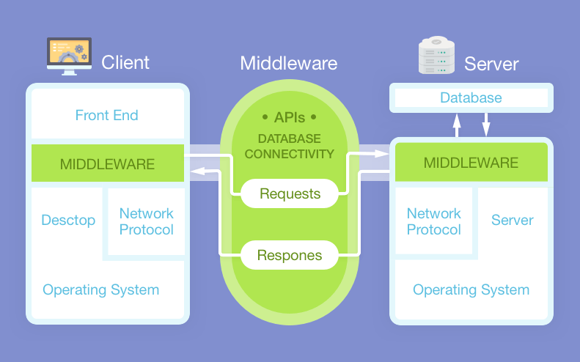

Slide 30
ADVANTAGES
It is fast, cost efficient and reliable.
Data redundancy and inconsistency.
Very user-friendly.
Easy accessibility of data.

Slide 31
DISADVANTAGES
Rise In Competition.
No Personal Shopper Assistant.
Lack Customer Loyalty.
Delay in Pickup.

Slide 32
LIMITATIONS
Due to time limit the survey was restricted.
Payment can’t possible before paper waste collection.

Slide 33
CONCLUSION
Objective of this project was to satisfy user’s requirement successfully implementation of this system design user friendly and easy operating system. Good communication and relation between waste collector and society can be established with the help of technology. Problem regarding proper disposal management and lack of society- management coordination are eliminated by application of technological skills in web development.

Slide 34
FUTURE ENHANCEMENT
OTP Generation for security purpose
Send text message after accepting or deleting pickup request.

Slide 35
THANK YOU…

